Slide 1
Intro HTML and CSS part 1
By Lea Ann Bradford for Girl Develop It San Diego

Slide 2
Welcome
Girl Develop It is here to provide affordable and accessible programs to learn software through mentorship and hands-on instruction.
Some “rules”
We are here for you
Every question is important
Help each other
Have fun

Slide 3
Introductions
Lea Ann Bradford
Software Developer @ Notch8
Former student of GDI front end series
Website: leaannbradford.com
Twitter: @LeaABradford
LinkedIn: linkedin.com/in/leaannbradford

Slide 4
Introductions
Tell us about yourself:
Who are you?
What do you hope to get out of this class?
What is your favorite or dream vacation destination?

Slide 5
Tools We Will Use Today
Web Browser:
Chrome - preferred
Safari
Firefox
Text Editor
Sublime Text - preferred
Atom
Notepad++

Slide 6
What Are We Going to Build?
Brand new to HTML/CSS:
Some HTML/CSS Experience
We are going to make a page about pandas:
You will code along with me, but feel free to experiment (it’s the best way to learn!)
Images, content, and some color ideas are already provided
Can be downloaded from:
http://www.leaannbradford.com/panda
You can make a page of your choice:
You can code along with me using your own ideas and assets
Some ideas are:
Your dream vacation spot
A list of your favorite restaurants, bands/songs, or movies
Cutest animal or list of favorite animals

Slide 7
Let’s Review Web Architecture
Visitor (Client) HTML, CSS, JavaScript
Web Server PHP, ASP, JSP, Ruby
3. Server responds by sending back the page requested
Internet
1. Visitor types the URL into their browser in hopes of seeing a page
2. Request is sent to
server for processing

Slide 8
Web Languages
The three languages that make up the part of the web page that the client will see:
HTML
CSS
JavaScript

Slide 9
What Makes Up a Web Page
HTML = Structure
CSS = Presentation
Your content

Slide 10
What is HTML?
Hyper Text Markup Language
Proposed and prototyped by Tim Berners-Lee in 1989
Formally adopted and began to see use in 1993
Written using a series of tags
Tags are parsed (analyzed) by web browsers and the result is displayed visually to the user
HTML5.1 is the newest specification
All modern browsers support most features of HTML5

Slide 11
What is CSS?
Cascading Style Sheets
Describes the presentation of a web page
Originally created to allow developers to separate HTML from the presentation
Properties include ability to format text, backgrounds, lists, borders and layout of a page
CSS can allow for the same markup to be presented in different styles for different rendering methods (responsive web design)
CSS3 is the newest specification
All modern browsers support most features of CSS3

Slide 12
Let’s Take a Look at HTML
Open a browser
Go to “https://www.girldevelopit.com”
Right click on the page and choose “View Page Source” or “Show Page Source”
Chrome click View => Developer => View Source

Slide 13
Basic HTML Structure
There are 2 main parts to HTML:
Doctype Declaration
Document Tree

Slide 14
Doctype Declaration
The declaration is not an HTML tag;
it is an instruction to the web browser about what version of HTML the page is written in
It is always the first thing on your page
In HTML 5, we have a simplified doctype:
<! DOCTYPE html >

Slide 15
Document Tree
A web page is considered a document tree because the markup is organized like the branches of a tree
Notice the symmetry of the tree
Tags have an opening and a closing
Tags are nested and indented
<!doctype html> <html>
<head>
<title>This is my web page</title>
</head>
<body>
<h1>This is my web page</h1>
<p>My page is a small page because it is just a sample</p>
</body>
</html>

Slide 16
The <html> Tag
Immediately after the doctype comes the html tag
Everything on the page is a descendent of the html tag
There are two main parts of the html section: the head and the body

Slide 17
The <head> Tag
The head tag contains the parts of the page that are not visible to the user with one exception
The title appears in the tab on the browser
The head tag contains meta data – the information that describes the document or associates it with scripts or stylesheets
<head>
<title>Welcome to My Page</title>
</head>

Slide 18
The <body> Tag
The body tag will contain your page content
If you want something to show in the browser, it belongs in the body tag
What appears on your page depends on what you decide to place in the body tag
<body>
<h1>My page headline</h1>
<p>This is my page content. Right now it doesn’t have a lot of information.</p>
</body>

Slide 19
Let’s Develop It!
Let’s create a folder on your desktop named “GDI”
Open your text editor
Create a new html document
Add your doctype declaration
Add html, head, and body tags
Add a title to your head tag
Don’t worry about the content yet, we’ll add that in a bit
Save your file in your folder with an .html extension, like panda.html

Slide 20
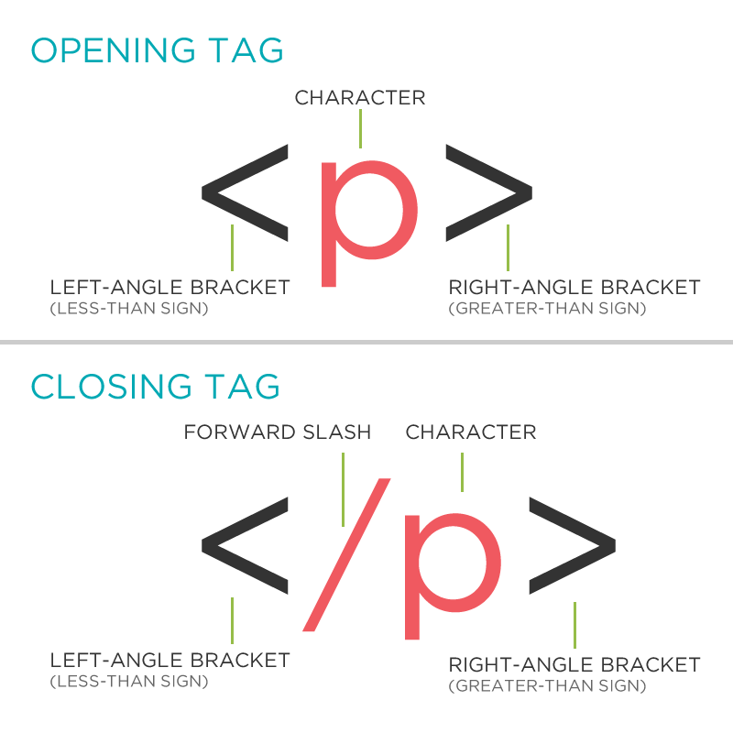
Anatomy of a Tag
A tag consists of an opening tag and a closing tag
Tags are enclosed in angle brackets
Closing tags match opening tags and begin with a forward slash

Slide 21
Anatomy of an Element
An element is an individual component of HTML
Some examples are paragraph, heading, table, list, link, image
An element consists of an opening tag, closing tag, and the content inside.
<tagname>Content inside</tagname>
<p>This is a paragraph</p>

Slide 22
Anatomy of an Element
Most elements are container elements, which means the need a opening and closing tag
Some elements are stand alone elements, which means they are self-closing and do not have content inside
<p>A paragraph tag is a container element and has content inside</p>
<hr />
<img src=“my-image.jpg” />

Slide 23
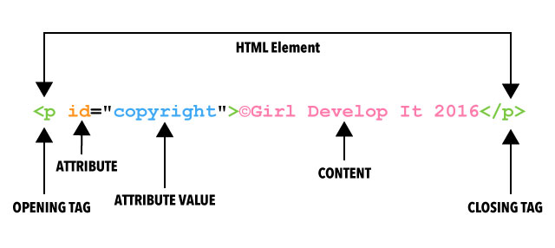
Attributes and Values
html tags sometimes need additional information
This information is provided in the form of attributes
Attributes live inside the <angle brackets>
Values are assigned to a given attribute
Values are placed inside “quote marks”
Some attributes are class, id, style, source

Slide 24
Nesting
HTML elements ”nest” inside one another
Your web page content is inside your <body> tags, or ”nested”
Elements that open first will close last
<body>
<p>This is my content. My paragraph is ”nested inside the body tag</p>
<p>The body tag opens first and closes last</p>
<p>Nested elements are indented from their parent elements</p>
</body>

Slide 25
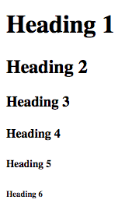
Let’s Talk About Some Tags
Heading Tags
You should only have one h1 tag on your page
The h1 tag should contain the most important content on your page
<h1>Heading 1</h1>
<h2>Heading 2</h2>
<h3>Heading 3</h3>
<h4>Heading 4</h4>
<h5>Heading 5</h5>
<h6>Heading 6</h6>

Slide 26
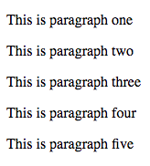
Let’s Talk About Some Tags
Paragraph tags contain paragraphs of content
<p>This is paragraph one</p>
<p>This is paragraph two</p>
<p>This is paragraph three</p>
<p>This is paragraph four</p>
<p>This is paragraph five</p>

Slide 27
Let’s Talk About Some Tags
Formatting tags can add some basic formatting to your content
<p>The is a paragraph of text. I would like <em> to have these words emphasized</em> because I think they are important.</p>
<p>If I want <strong>some text to appear bold</strong>, I will add a strong tag.</p>

Slide 28
Comments
Code comments are an important way for you to remind yourself what your intent was when writing code
<!-- this is what a a code comment in html looks like -->

Slide 29
Let’s Develop It!
Let’s go back to our page and add some content
Add some header tags
Add some paragraphs
Add some formatting tags
Add at least one code comment

Slide 30
Let’s Talk About Lists
Ordered Lists (numbered):
<ol>
<li>First one</li>
<li>Second one</li>
</ol>
Unordered Lists (bullets):
<ul>
<li>list item</li>
<li>another list item</li>
</ul>

Slide 31
Lets Talk About Tables
Tables are a way to represent complex information in a grid format
Tables are made up of rows and columns
<table>
<tr>
<th>Column 1 Header</th>
<th>Column 2 Header</th>
</tr>
<tr>
<td>column 1 data</td>
<td>column 2 data</td>
</tr>
</table>

Slide 32
Let’s Develop It
Let’s add a list to your web page
Let’s add a table to your web page

Slide 33
Let’s Talk About Links
Links are the heart of the web
Links connect your pages together
Links connect your page to the rest of the web
A link tag must have attributes
Links can be placed around text or images

Slide 34
The <a> Tag
Links have at least two components
Tag <a></a>
href attribute: “http://www.girldevelopit.com”
If you want your link to open in a new tab, you can add the target attribute with the value of “_blank”
You can link to a specific section on a page by adding an ID attribute, and linking to it
<a href=“https://www.girldevelopit.com” target=“_blank”>Visit the Girl Develop It website</a>
<a href=“#main-heading”>My Main Heading</a>

Slide 35
The <a> Tag
Links can also have attributes that tell the link to launch an email program
<a href=“mailto:hello@leaannbradford.com”>Email Me!</a>

Slide 36
Let’s Talk About Images
Images are self closing and have three components:
Tag: <img />
Src attribute: ”https://assets.brandfolder.com/4btx26fz/original/circle-gdi-logo.png”
Alt attribute: “Girl Develop It Logo”
<img src=“https://assets.brandfolder.com/4btx26fz/original/circle-gdi-logo.png” alt=“Girl Develop It Logo” />

Slide 37
Absolute vs. Relative Paths
Absolute Paths:
Refer to a specific location of a file
Typically used when pointing to a link that is not on your own domain
<a href=“https://www.google.com”>Visit Google</a>
Relative Paths
Change depending on the page a link is on
Links in the same directory need no path information
<img src=“myimage.png” />
Links in a another directory will need a path
<img src=“img/myimage.png />

Slide 38
Let’s Develop It
Let’s add some links to your web page
Add navigation at the top to link to each heading
Add a link in your navigation to a panda cam
Add a link to email for more information
Let’s add some images to your web page

Slide 39
Questions?

