Slide 1
Pulling weeds and planting seeds: Tending the Samvera ecosystem through pull requests
Chris Colvard
Avalon Media System
Indiana University Libraries

Slide 2
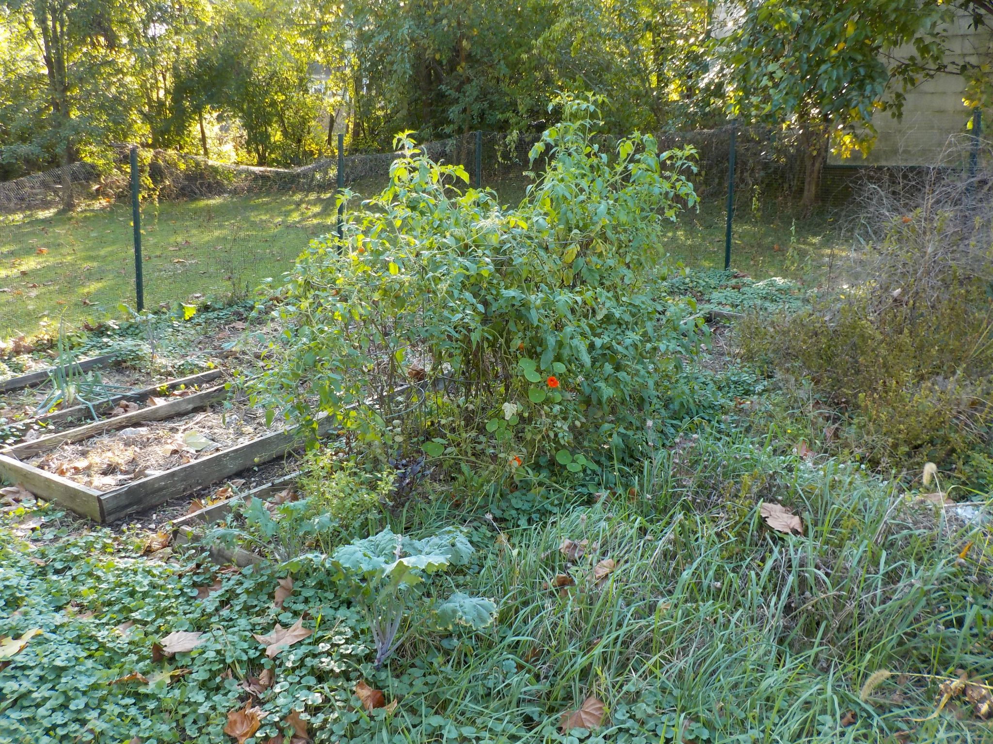
The Garden
Notes:
The Samvera ecosystem is like my garden there are beds that have been neglected and are overgrown with weeds (out of date dependencies, failing CI builds, bad links in documentation, etc.), beds that are underutilized and could something planted (improvements and new features), or beds that are doing well but just need a little weeding and pruning (bug fixes, documentation improvements, remove deprecation warnings).

Slide 3
What is a pull request?
Pull requests let you tell others about changes you've pushed to a branch in a repository on GitHub. Once a pull request is opened, you can discuss and review the potential changes with collaborators and add follow-up commits before your changes are merged into the base branch.
https://docs.github.com/en/github/collaborating-with-pull-requests/proposing-changes-to-your-work-with-pull-requests/about-pull-requests
Notes:
Pull requests are the tool we have for making changes in version controlled pieces of the Samvera ecosystem in GitHub. In GitLab these are called merge requests.

Slide 4
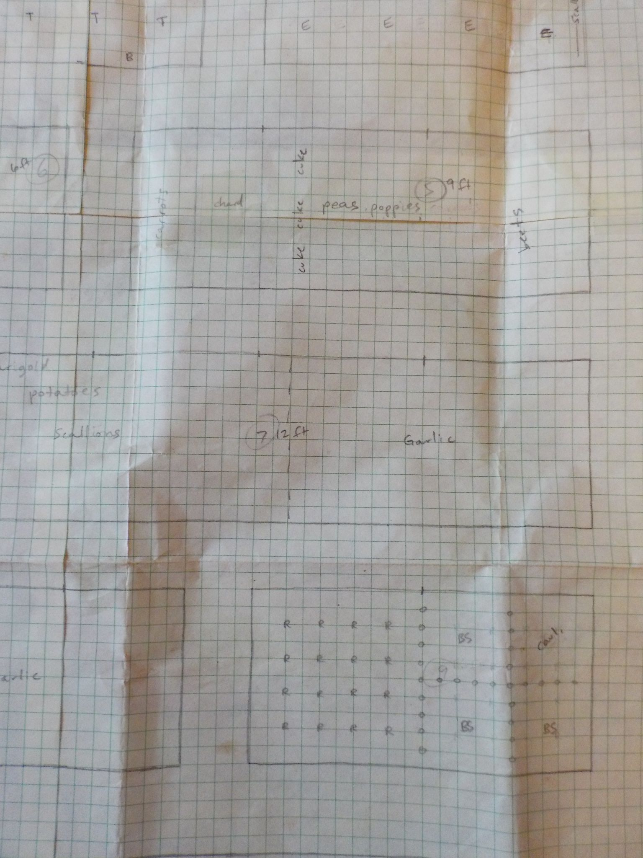
Planning a contribution
Idea for a new feature, improvement, find a bug, or pick existing ticket
Create an issue in GitHub
Get feedback
GitHub
Slack
Tech Call
Samvera-tech mailing list
Notes:
Open an issue for wiki links in https://github.com/samvera/maintenance/blob/main/templates/SUPPORT.md

Slide 5
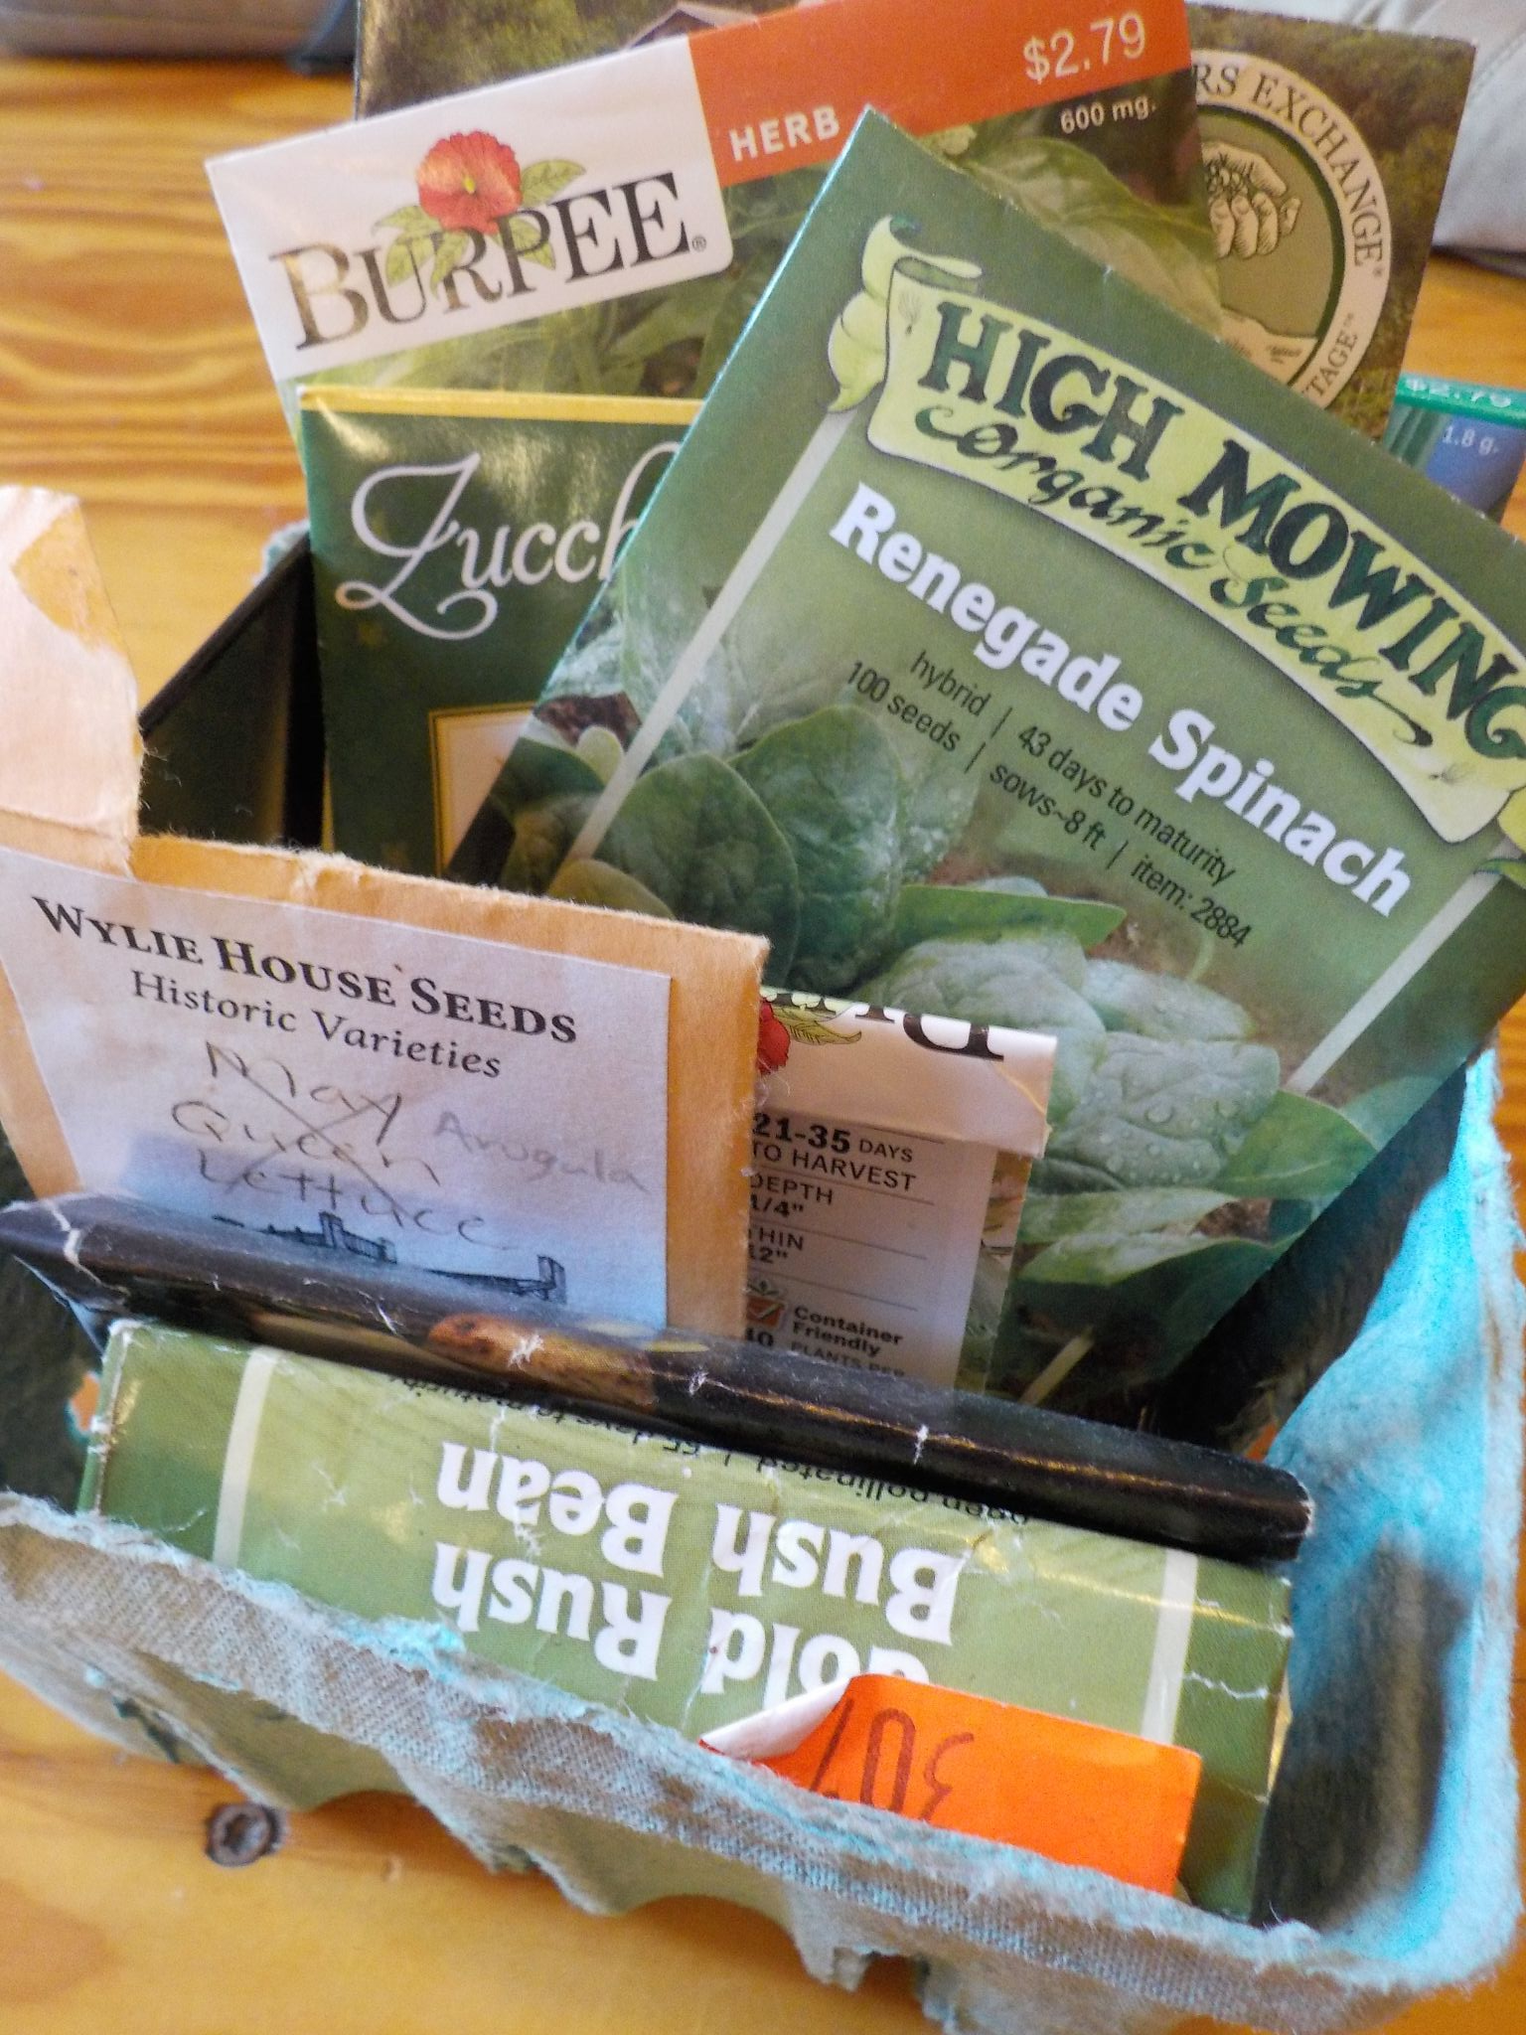
Making a pull request
Fork repository and create branch
Or create a branch in samvera repository
Make changes and commit
Add tests and documentation
Check style by running rubocop
Run tests with rspec
Keep changes scoped to issue
Squash commits
Push your changes to your branch
Open a pull request in GitHub
Keep title brief
Provide detailed description with:
Summary of key changes
Rationale
Link to issue
Any related links or information
If work in progress, create it as a draft
Notes:
Use online GitHub editor to fix wiki links in https://github.com/samvera/maintenance/blob/main/templates/SUPPORT.md Links should be https://samvera.atlassian.net/wiki/spaces/samvera/pages/405211682/Getting+Started+in+the+Samvera+Community#Join-the-Samvera-Slack-workspace and https://samvera.atlassian.net/wiki/spaces/samvera/pages/405211682/Getting+Started+in+the+Samvera+Community

Slide 6
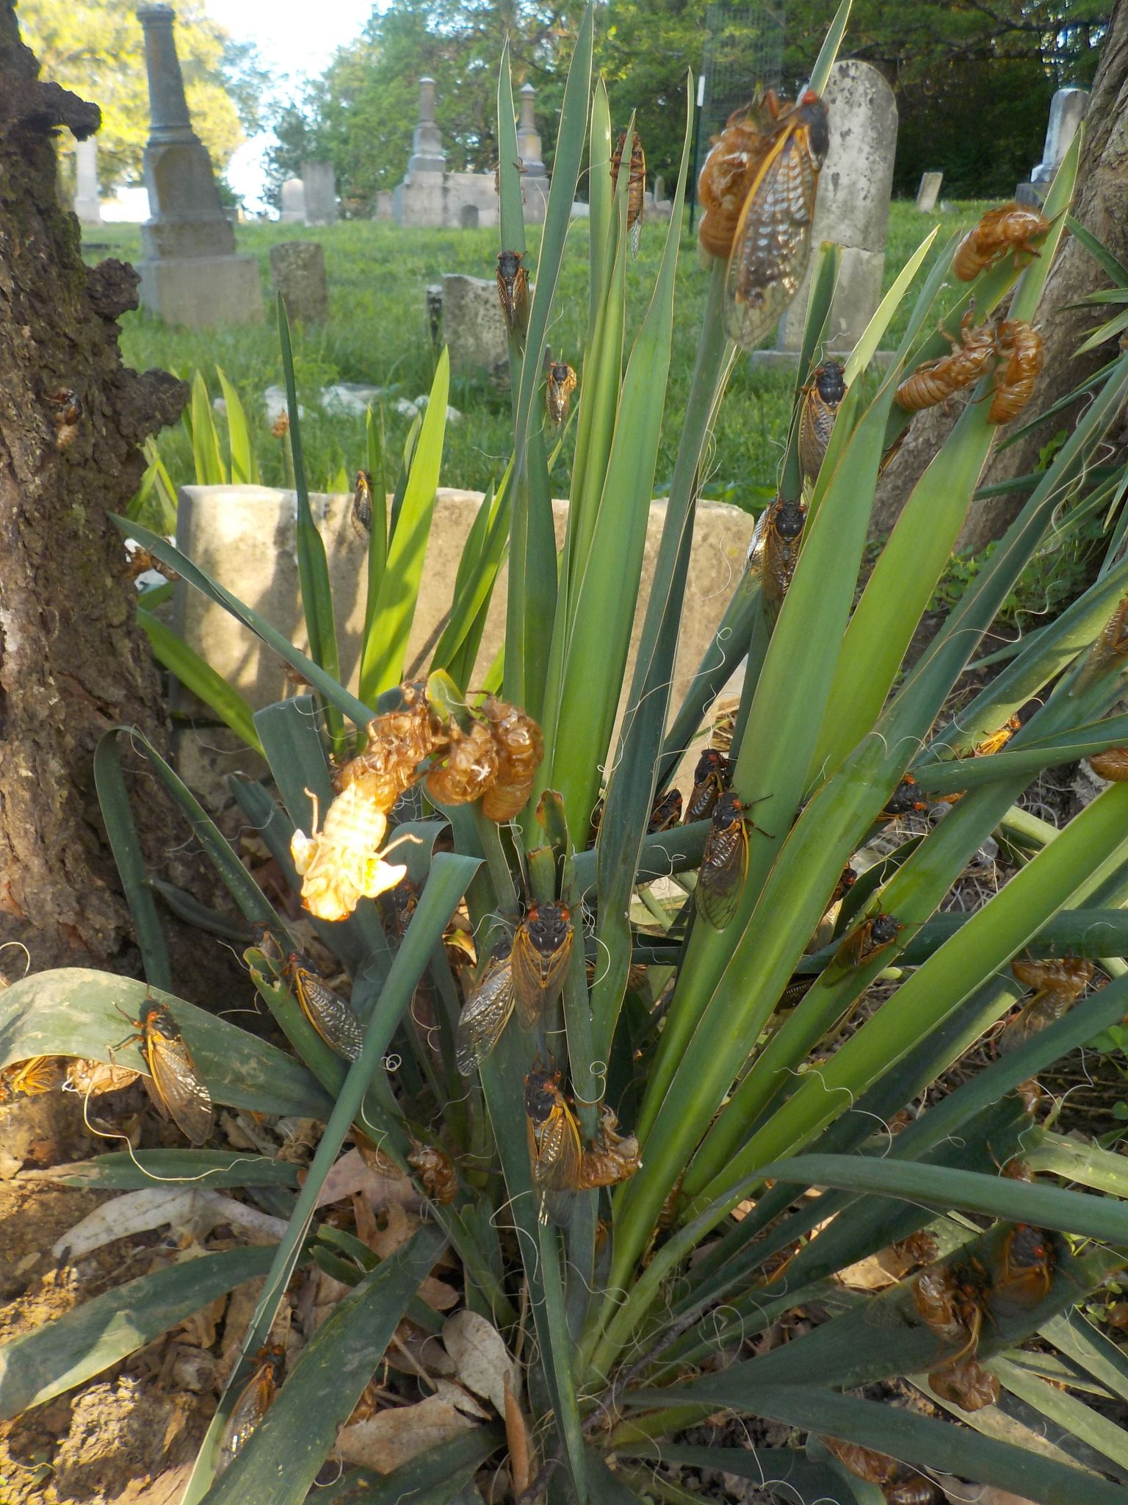
Review process
Automated checks
CircleCI (rubocop, rspec, code coverage, etc.)
Hound (JS lint)
Other checks
Submitter fixes any issues
Code review
Check for CLA on file
Check for backwards compatibility
Suggest improvements (avoiding scope creep)
Ask questions
Submitter responds and makes changes
Reviewer approves
Waits until automated checks pass
Waits until discussion finished
Notes:
Drop link for new pull request into #dev slack to get a reviewer.
Take a look at https://github.com/samvera/hyrax/pull/5217?

Slide 7
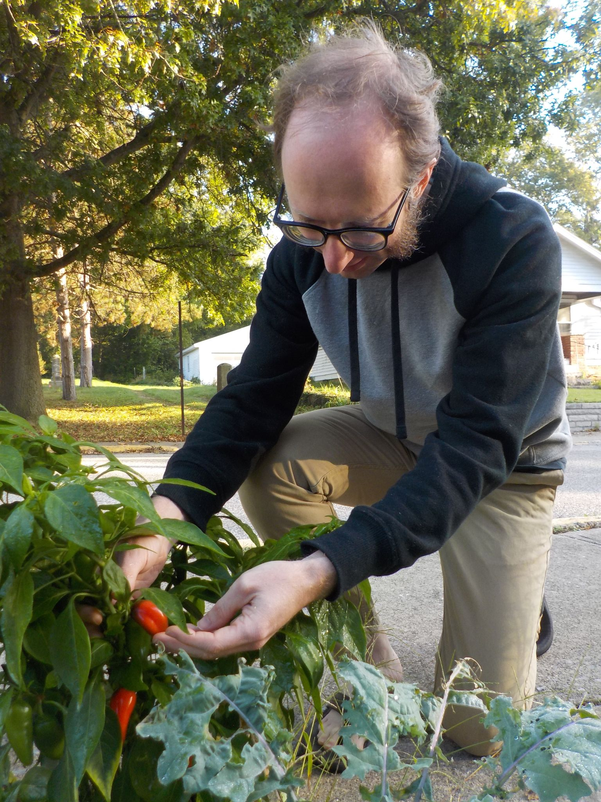
Merging and Releasing
Merge pull request
Once approved, anyone can merge
Once merged it still needs to be released...
Create pull request to bump version number
Check with product owner
Once version number PR is merged, run `rake release`
Needs rubygems.org permission
See https://github.com/samvera/maintenance/blob/main/script/grant_revoke_gem_authority.rb
Notes:
Merge pull request that hopefully got approved.

Slide 8
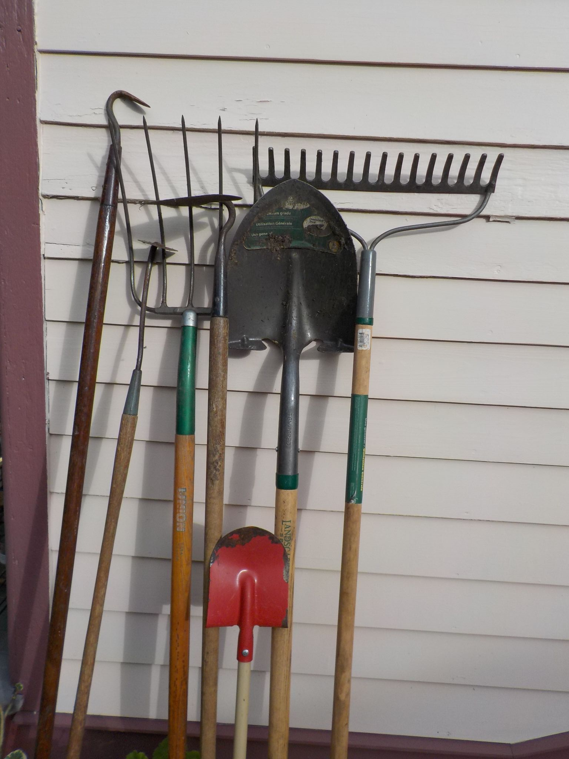
Pull Request Tips
Create a draft pull request and get feedback early
Don’t hesitate to ask for feedback / review
slack, tech call, @mentions on github
Bring your PR to review time during the tech call
Reviewer from different partner if possible
Many small PRs better than single huge PR
Unrelated status check failures
Put a comment in the pull request and/or ask for help
Delete branch/fork after merging
Pull requests are conversations
All contributions welcome; All reviewers welcome
Notes:
Ask about getting added to https://github.com/orgs/samvera/teams/contributors

Slide 9
Resources
https://samvera.github.io/how-to-pr.html
https://github.com/samvera/maintenance/blob/main/CONTRIBUTING.md
https://samvera.github.io/review.html
https://samvera.github.io/pr-checklist.html
https://medium.com/@sandya.sankarram/unlearning-toxic-behaviors-in-a-code-review-culture-b7c295452a3c
Notes:
This last link was shared and discussed in Samvera slack a few years ago and was formative for me about code reviews.

Slide 10
Be in touch!
Samvera tech calls (Wednesdays 9 Pacific / 12 Eastern / 5PM GMT) https://samvera.atlassian.net/wiki/spaces/samvera/pages/405211059/Notes+from+Tech+Meetings+and+Calls
Slack (#dev, #avalon, #documentation, #devops, #hyku, #hyrax, #valkyrie, etc.) https://samvera.atlassian.net/wiki/spaces/samvera/pages/405211682/Getting+Started+in+the+Samvera+Community#Join-the-Samvera-Slack-workspace
Mailing list (samvera-tech) https://groups.google.com/forum/#!forum/samvera-tech/join

